Slide 1
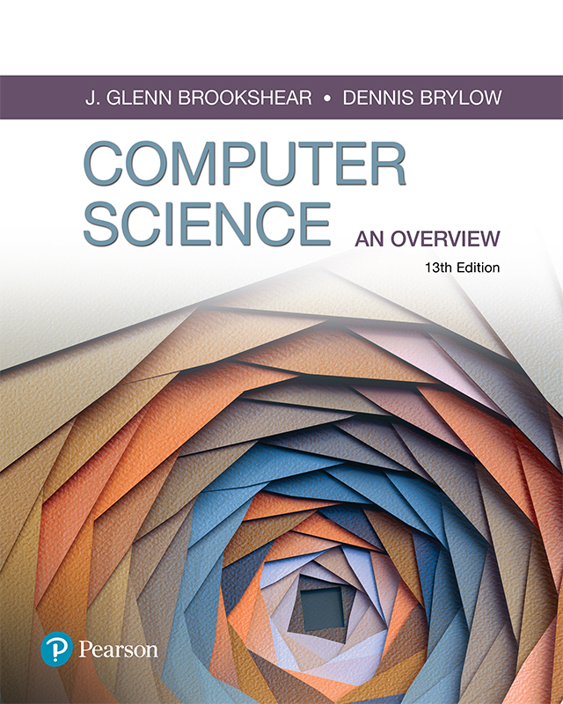
Computer Science An Overview
13th Edition
Chapter 2
Data Manipulation

Slide 2
Chapter 2: Data Manipulation
2.1 Computer Architecture
2.2 Machine Language
2.3 Program Execution
2.4 Arithmetic/Logic
2.6 Program Data Manipulation
2.7 Other Architectures

Slide 3
2.1 Computer Architecture
Central Processing Unit (CPU)
  Arithmetic/Logic Unit – carries out arithmetic and logic operations.
  Control Unit – directs the operation of the processor.
  Register Unit – data storage space for processing.
    General purpose registers – stores both data and addresses.
    Special purpose registers – has a specific control or data handling task (accumulators, program counters, instructions, etc.)
Bus – communicates/transfers data between main memory and different parts of CPU
Main Memory – primary workspace of the computer that interacts with application software

Slide 4
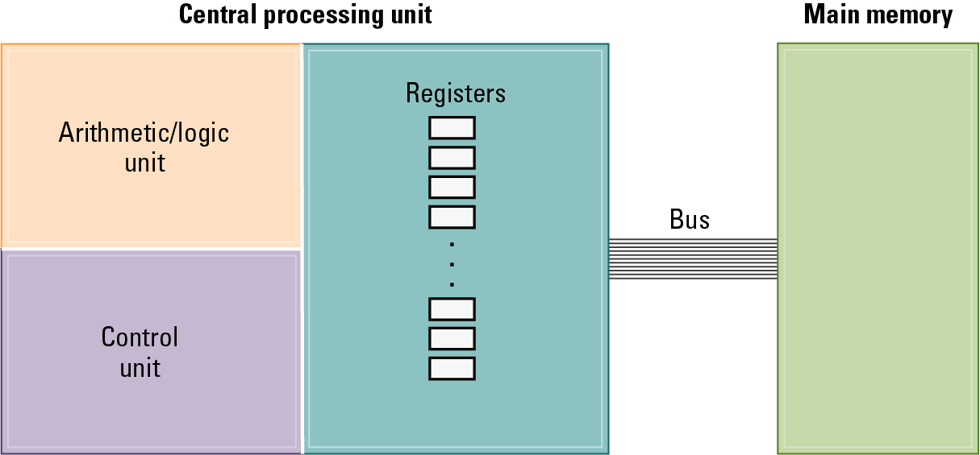
Stored Program Concept
A program can be encoded as bit patterns and stored in Main Memory. From there, the Control Unit can extract, decode, and execute instructions.
Instead of rewiring the CPU, the program can be altered by changing the contents of Main Memory.

Slide 5
2.2 Machine Language
Machine instruction: An instruction encoded as a bit pattern recognizable by the CPU
Machine language: The set of all instructions recognized by a machine
Machine instruction types:
  Data Transfer: copy data from one location to another
  (e.g. LOAD, STORE, MOVE)
  Arithmetic/Logic: operations on bit patterns
  (e.g. +, -, *, /, AND, OR, SHIFT, ROTATE)
  Control: direct the execution of the program
  (e.g. JUMP, BRANCH)

Slide 6
Machine Language Philosophies
Reduced Instruction Set Computing (RISC)
  Few, simple, efficient, and fast instructions
  One instruction per clock cycle
  Examples: PowerPC from Apple/IBM/Motorola
  and ARM (Advanced RISC Machines)
Complex Instruction Set Computing (CISC)
  Many, convenient, and powerful instructions
  Instructions are complex - 1 instruction can span multiple clock cycles
  Example: Intel
RISC tends to be 2-4x faster because of its limited and more simple instruction set

Slide 7
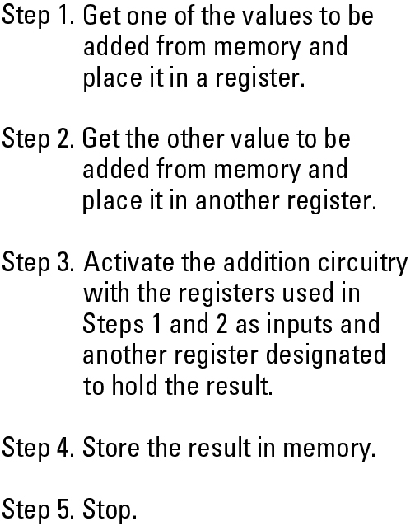
Adding values stored in memory

Slide 8
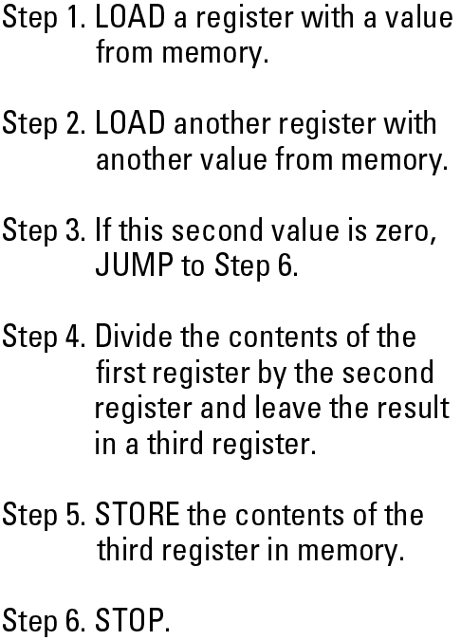
Dividing values stored in memory

Slide 9
Vole: An Illustrative Machine Language
Vole Processor has:
  16 general-purpose registers labeled 0-15
  Reference registers in hexadecimal as 0x0 – 0xF
  256 main memory cells labeled 0-255 (each cell = 8 bits)
  Reference memory cells in hexadecimal as 0x00 – 0xFF
Op-code: Specifies which operation to execute
  Examples: SHIFT, JUMP, XOR, STORE
Operand: More detailed information about the operation
  Example: if STORE, operand field indicates (1) which register contains the data to be stored and (2) which memory cell is to receive the data.

Slide 10
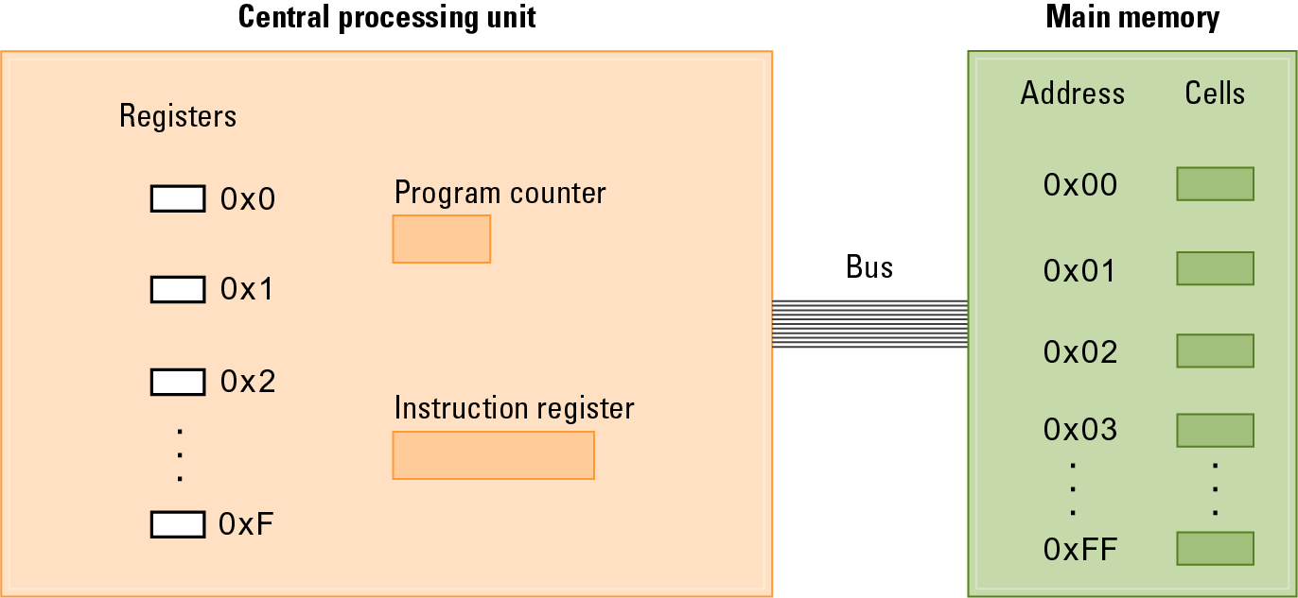
The architecture of the Vole

Slide 11
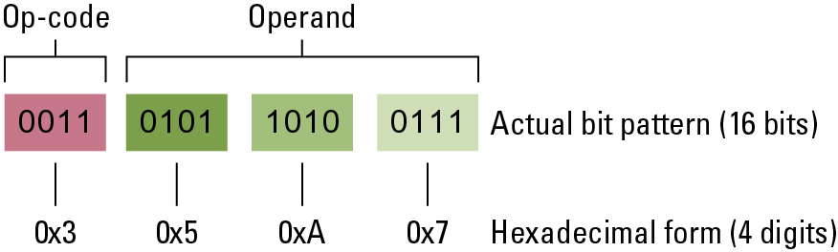
Composition of a Vole instruction
Language of Vole consists of 12 opcodes (see Appendix C)
A Vole instruction consists of 16 bits
  Opcode: first 4 bits (or first hexadecimal digit)
  Operand: last 12 bits (or 3 hexadecimal digits)

Slide 12
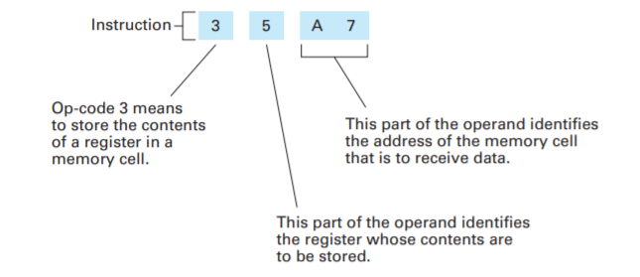
Decoding the instruction 0x35A7

Slide 13
2.3 Program Execution
Controlled by two special purpose registers
  Instruction register - holds current instruction
  Program counter - holds address of next instruction
Machine Cycle: (repeat these 3 steps)
  Fetch, Decode, Execute
Clock Speed – speed at which computer can perform a machine cycle (3.2Ghz – 3.2 billion cycles/second)
  The faster the clock speed, the faster the machine can perform one complete machine cycle and thus the better it performs overall.
  Measuring clock speed alone is not a great measure of performance – must also look at benchmarking, which is comparison of performance between 2 machines executing the same program.

Slide 14
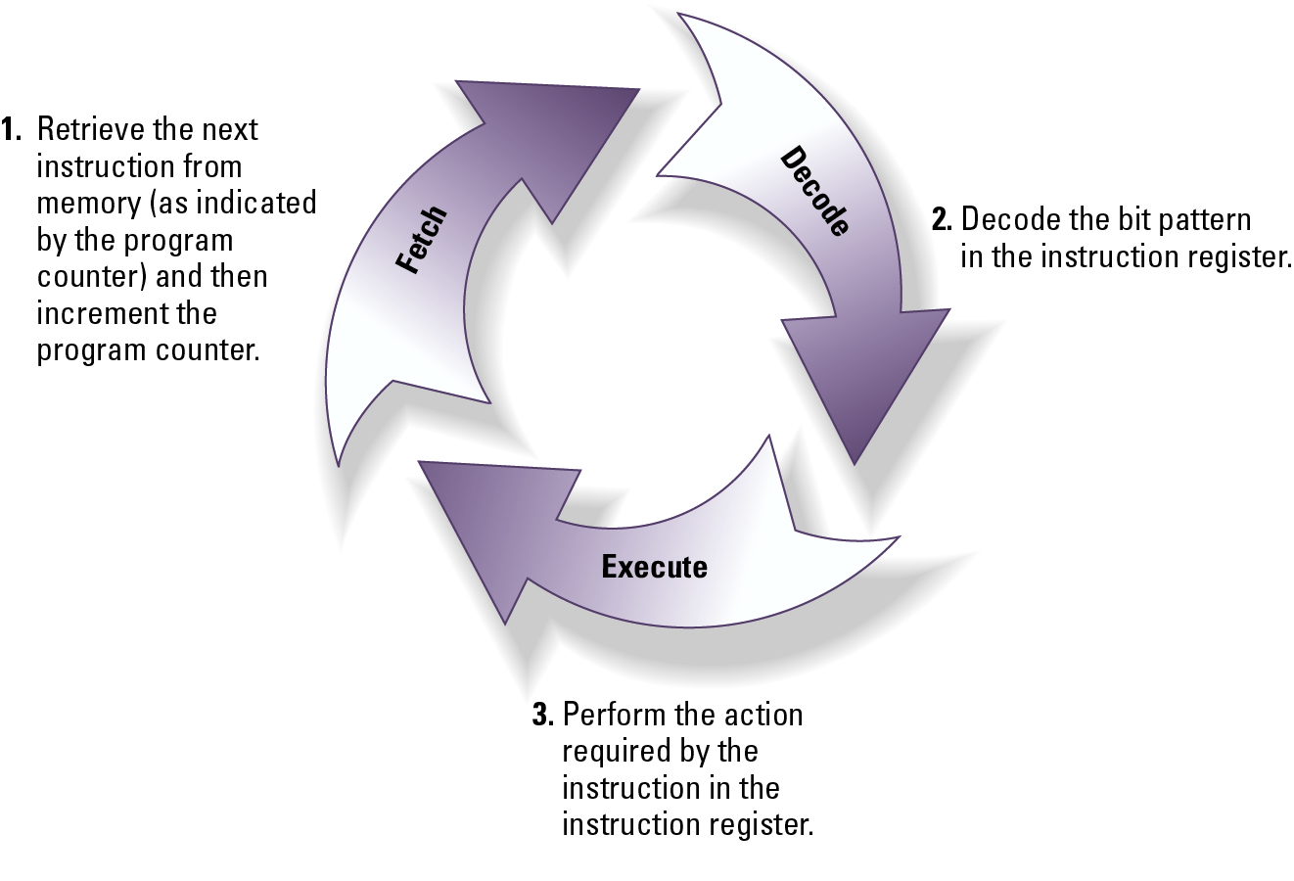
The Machine Cycle

Slide 15
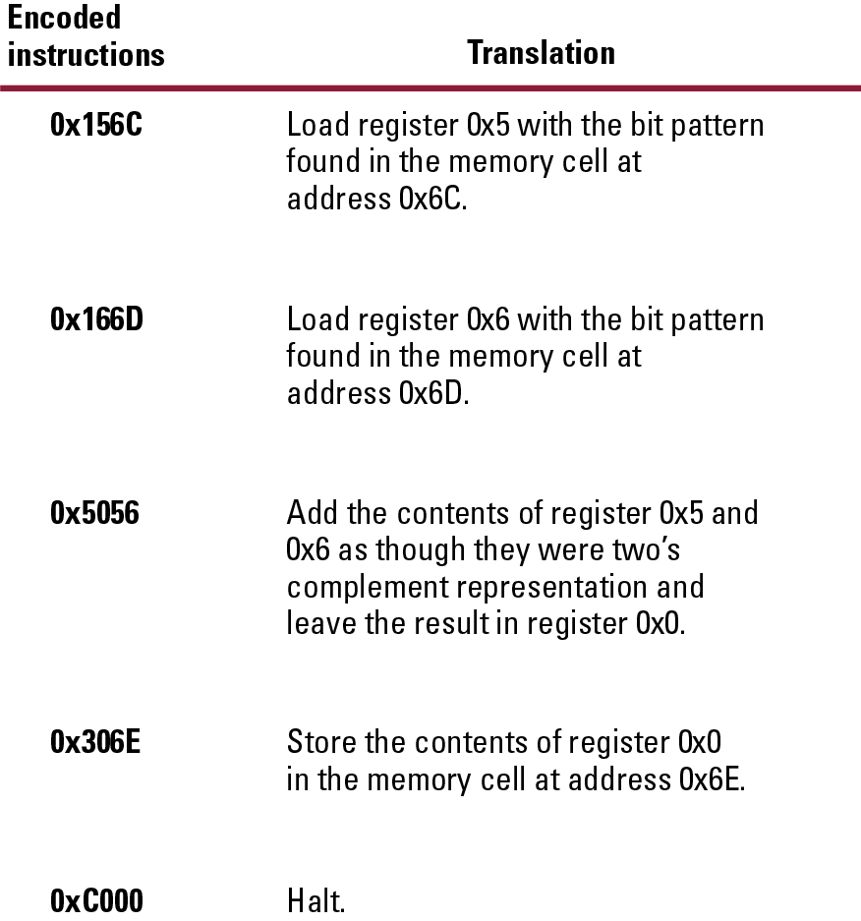
“Add” Program –
Adding values stored in memory

Slide 16
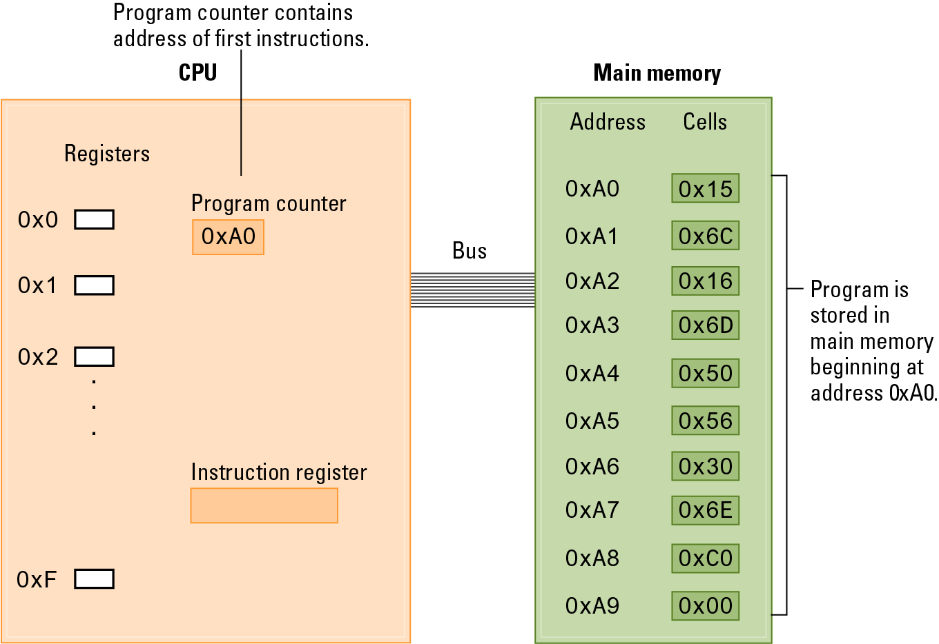
“Add” Program –
Stored in main memory ready for execution

Slide 17
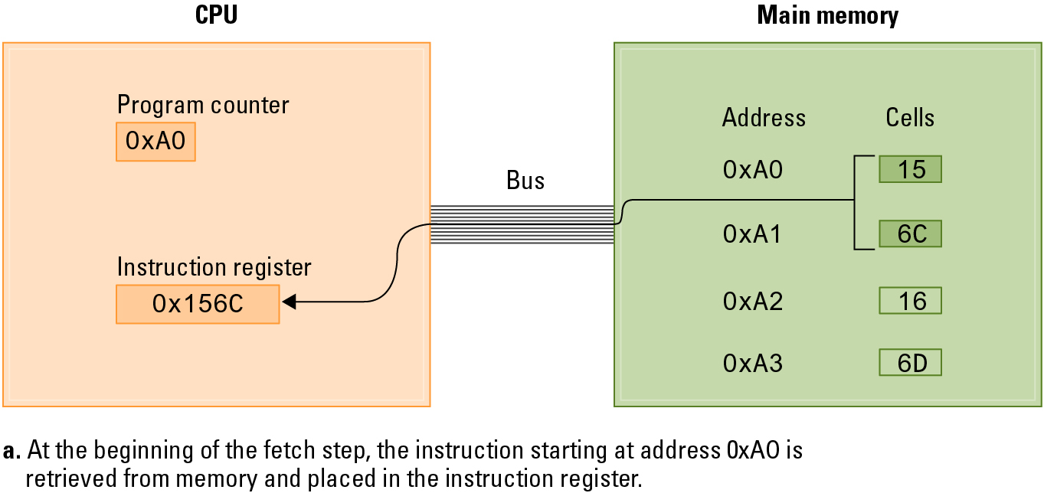
“Add” Program –
Performing the fetch step of the machine cycle

Slide 18
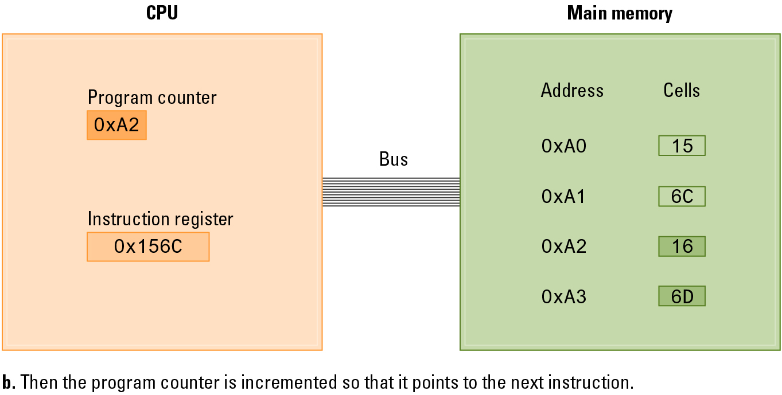
“Add” Program –
Performing the fetch step of the machine cycle

Slide 19


2.4 Arithmetic/Logic Instructions
Logic Operations:
  AND, OR, EXCLUSIVE OR

Slide 20
2.4 Arithmetic/Logic Instructions
Rotation and Shift Operations (ROTATE):
  circular shift (or “rotation”)
    Shifting bits one to the right, and rotating the rightmost bit back to be leftmost.
    Vole contains only a right circular shift (opcode 0xA)
    10110110 becomes 01011011
  logical shift (or arithmetic shift) (not in Vole)
    populate lost bit with same value as it had previously
    shift to left (number * 2) - 0110 to 1100 – 6 to 12
    shift to right (number / 2) – 0110 to 1011 – 6 to 3

Slide 21
2.4 Arithmetic/Logic Instructions
Arithmetic Operations:
  ADD
  Small computers only include operations that are necessary. Consider in bit logic:
    subtraction = addition and negation
    multiplication = repeated addition
    division = repeated subtraction
  Vole includes two different ADD opcodes
    ADD as two’s complement (0x5) – straightforward column-by-column addition
    ADD as floating point values (0x6) – extract mantissa, shift left/right based on exponent, check sign bits, perform addition, and store result as a floating-point value

Slide 22
2.6 Programming Data Manipulation
Programing languages shields users from details of the machine:
  A single Python statement might map to one, tens, or hundreds of machine instructions
  Programmer does not need to know if the processor is RISC or CISC
  Assigning variables surely involves LOAD, STORE, and MOVE op-codes

Slide 23
Bitwise Problems as Python Code
print(bin(0b10011010 & 0b11001001))
# Prints '0b10001000'
print(bin(0b10011010 | 0b11001001))
# Prints '0b11011011'
print(bin(0b10011010 ^ 0b11001001))
# Prints '0b1010011'

Slide 24
Control Structures
If statement:
if (water_temp > 140):
print('Bath water too hot!')
While statement:
while (n < 10):
print(n)
n = n + 1

Slide 25
2.7 Other Architectures
Technologies to increase throughput:
  Pipelining: Overlap steps of the machine cycle
  Parallel Processing: Use multiple processors simultaneously
    SISD: Single Instruction, Single Data
      No parallel processing
    MIMD: Multiple Instruction, Multiple Data
      Different programs, different data
    SIMD: Single Instruction, Multiple Data
      Same program, different data

